Slide 1
Banking Application architecture & implementation overview

Slide 2
Objective of the task
To provide transition of Global Bank’s monolithic banking application to a microservice-based application using NodeJS.
Provide secure, scalable and highly available platform.
Support various banking operations like account management, transaction processing, customer management & loan services.
Ensure data security and protection.

Slide 3
Deliverables for this task
Architecture Document: High-Level architecture document that details the design of the microservices, technology stack, database design and security considerations of the application.
Implementation in NodeJS: Demo of the implementation of two microservices of the banking application.
CI/CD Pipeline: Documentation and source code files for CI/CD pipeline setup for testing, building & deployment of the microservices.
Code & configuration: Github repository with source code with data model, deployment files, etc.

Slide 4
High-level architecture and design
The following section describes the high-level architecture & design considerations of the new Banking application.
Detailed documentation of the same is attached below.

Slide 5
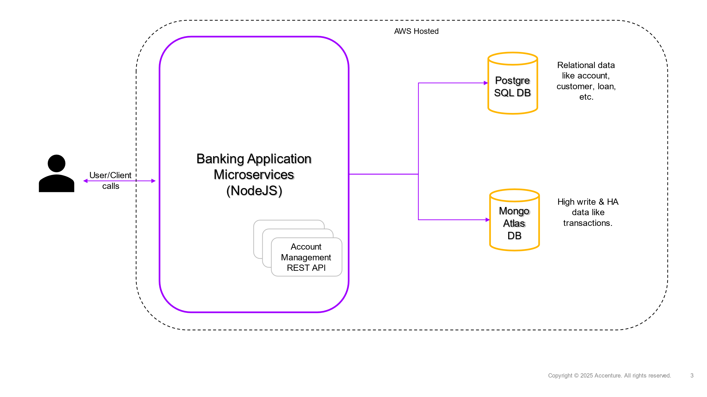
High-level design representation
System Components:
The application will have core banking modules of Account Management, Transaction Services, Customer Management & Loan Services as individual NodeJS microservices.
Communication pattern would be RESTful APIs (HTTP/HTTPS) with JSON as the data format.
Authentication & Authorization would be required for all API calls.
Source code can be found in Github at: https://github.com/sbs-sat/banking-app

Slide 6
High-level architecture and design (cont’d)
Databases and Data Management:
Each microservice will have its own isolated database table/collection to ensure loose coupling.
Choice of database depends on the nature of the microservice.
Account management, Customer management & Loan services handle structured data like account details, balances, etc. Hence relational database, PostgreSQL would be used for the same.
Transaction Service would need to handle high throughput and availability for transactional data. Hence Distributed NoSQL database, MongoDB would be used.
Set up multi-AZ (Availability Zone) replication for databases to ensure high availability.

Slide 7
High-level architecture and design (cont’d)
Cloud provider & native services:
Amazon Webservices (AWS) has been chosen as the Cloud Provider for its scalable, reliable & highly comprehensive set of managed services for running NodeJS microservices and databases.
Cloud-native services that can be used for this application are AWS EC2, RDS, MongoDB on Atlas, S3, SQS/SNS.
Auto-scaling groups to be used to ensure system can dynamically scale up/down based on demand.
AWS Elastic Load Balancer to distribute traffic across multiple instances and scale, as necessary.

Slide 8
High-level architecture and design (cont’d)
Security & Compliance:
OAuth 2.0 & JWT tokens to be used for authentication and authorization for all microservices.
AES-256 encryption for storing sensitive data such as account details and transaction records in database.
TLS 1.2+ to be configured for securing data in transit between microservices.
PCI-DSS compliance adherence by encrypting card information and audit logging requirements.

Slide 9
High-level architecture and design (cont’d)
CI/CD & Deployment strategy:
All microservices will be individually containerized using Docker & Kubernetes(K8S).
Multi-region Deployment to ensure High Availability (HA) and Disaster Recovery (DR).
Github actions configuration would be used for CI/CD pipeline for the microservices which would automate their test, build & deployment.
Blue-Green Deployment strategy is chosen as this is a Banking application and should have zero/no downtime which is ensured by this strategy. This also ensures instant rollback, reduced deployment risk & better user experience for the services.
Detailed documentation is captured here:

Slide 10
Benefits & Conclusion
For Customers (End user):
Seamless, Faster & secure transactions.
24/7 Service Availability.
For Business:
Lower Operational costs
Faster market adaptation for new features and enhancements.
Enhanced security & compliance.

